Slide 1
TERPCravingz
Restaurant Consultancy Services
2019.12.2 Aishwarya Bhangale Cindy Chang Wenjing Cui Huyen Nguyen Jiakun Luo

Slide 2


Background
Platform
Clients
Entrepreneurs
Consultancy
People who are looking for restaurant business opportunities nearby UMD and needed analysis insights for decision making
TERPCravingz
A local restaurant review platform that showcases restaurant information, restaurant review information and UMD Shuttles to the restaurant of choice.
Search
Consumers
How do I get to a Vegetarian restaurant that has above average rating and on UMD shuttle routes?

Slide 3
Introduction
Entrepreneur Demand:
Easy connectivity
Neither too cluttered nor too deserted with neighbouring restaurants
Well-received, well-known and affordable restaurant themes (Eg: Breweries, bars, Vegan Food,etc)
Extra Functionality :
Inform customers about the closest UMD shuttle stop to a chosen restaurant.

Slide 4
Outline
Background
Introduction
Data
Conceptual Database Design: ER diagram
Logical Database Design: relational schema
Physical Database Design
Use Cases
Application

Slide 5

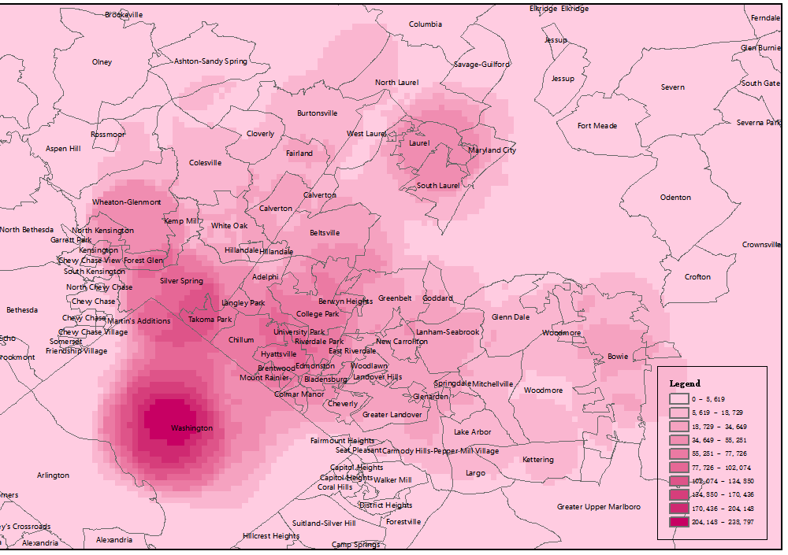
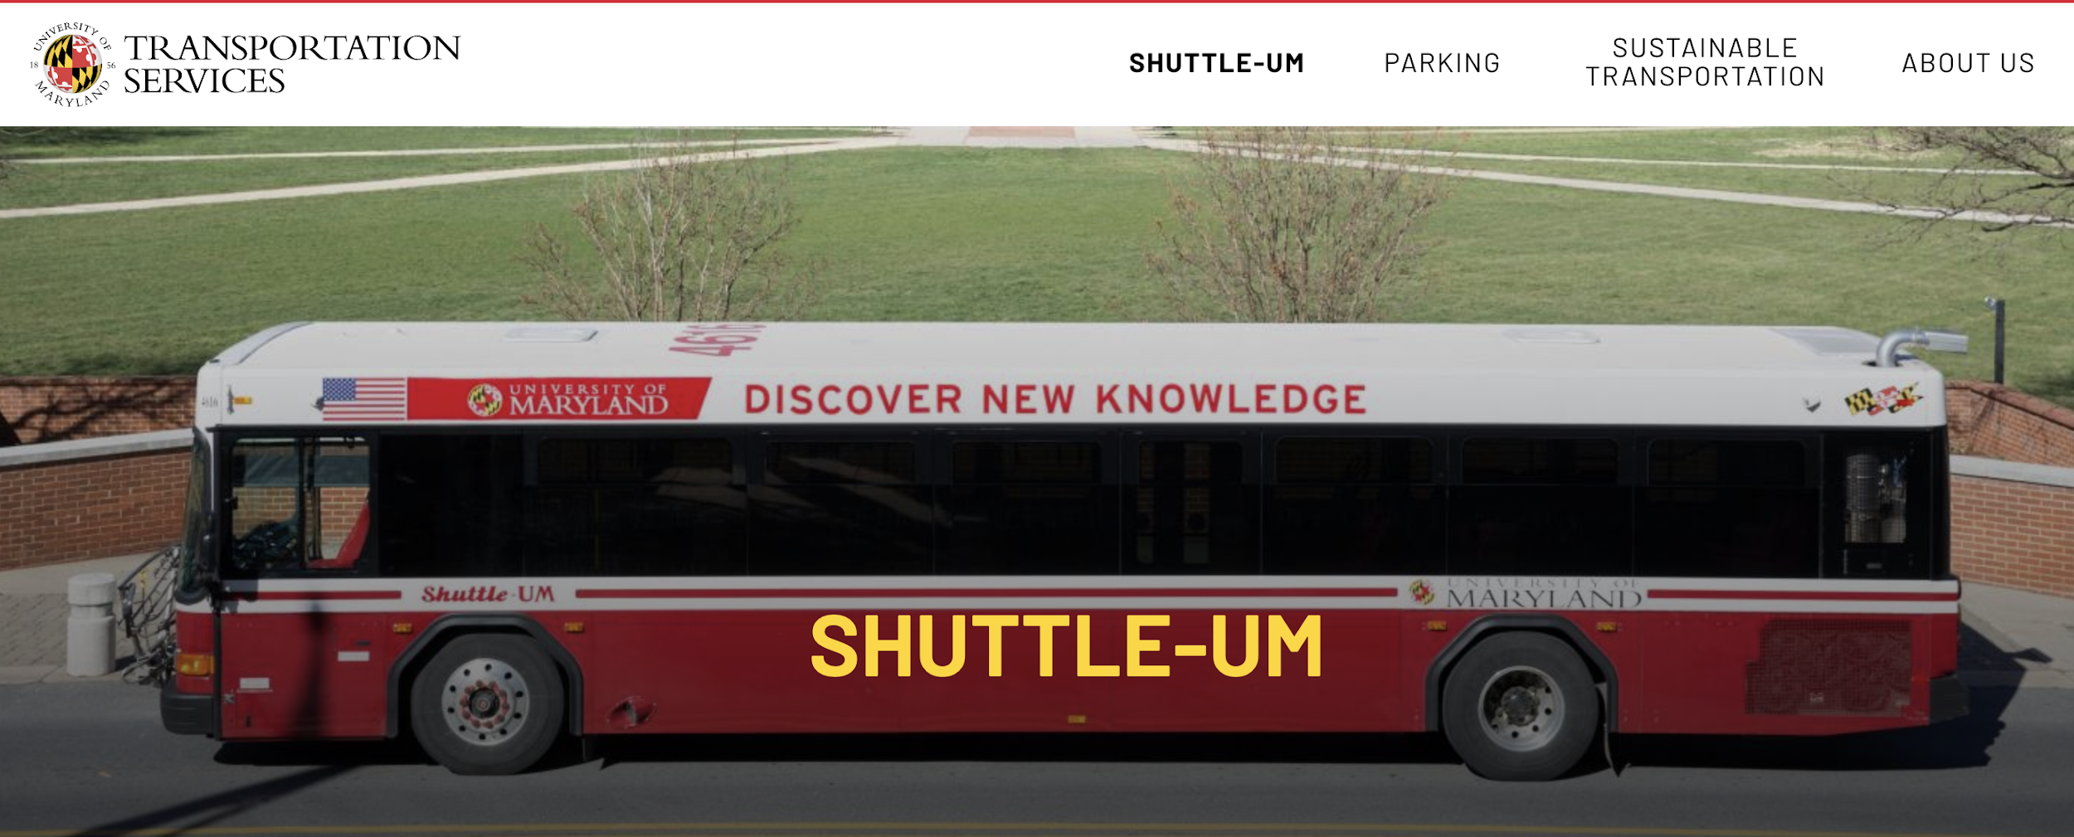

Data-1: Summary
Data of 2793 restaurants in 15 cities nearby UMD
Data of all 25 Shuttle-UM route schedules with 315 bus stops

Slide 6
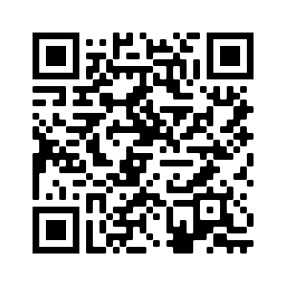

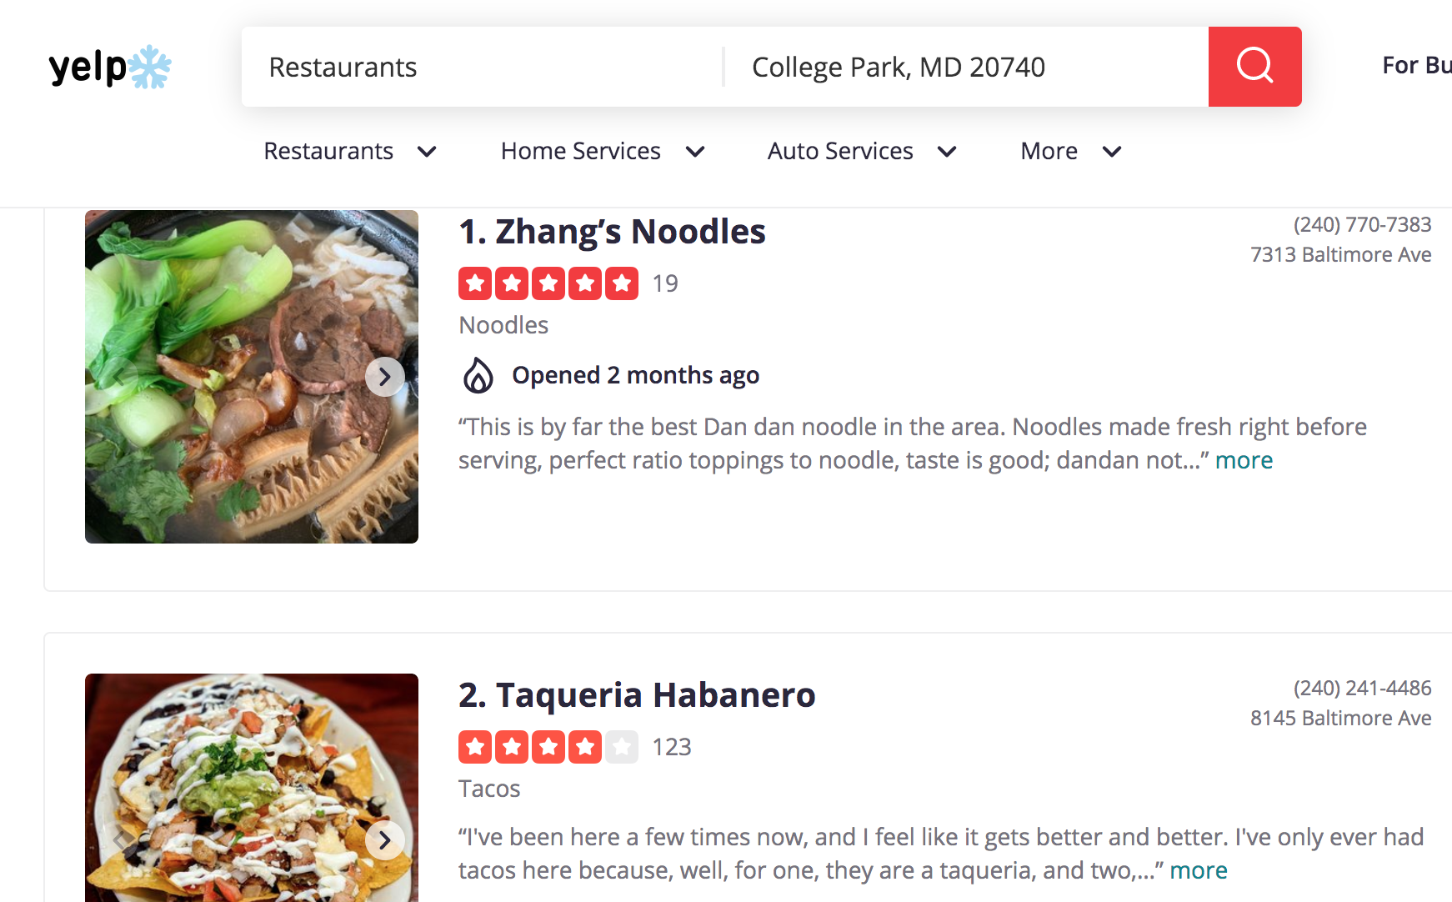

Data-2: Source
Scrape data from Yelp and Nextbus using Yelp API and NextBus API:
Yelp + Shuttle data extraction codes
(our github link)
Obtained up to 250,000 restaurants/day + all shuttle schedules

Slide 7
Data-3:
Processing
Restaurant (2793)
Review (7980)
Customer (5525)
ID, name,
Address, open hours, rating,
number of reviews,
coordinates, etc.
ID,
written date,
Text,
Review rating
ID,
name
Yelp.com: 2793 restaurants in 15 cities nearby UMD
Total:
9 Tables
Shuttle (25)
Stop (315)
UMD DOTs: 25 bus route schedules with 315 bus stops
ID, number, name, bus final destination
ID, name, coordinates

Slide 8



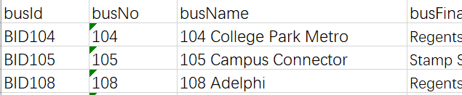
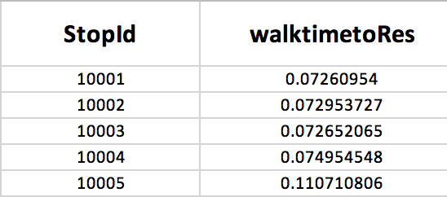
Data-3: Processing
?
- Find the nearest stop to the restaurant
- Walk time from the nearest stop to restaurant

Slide 9
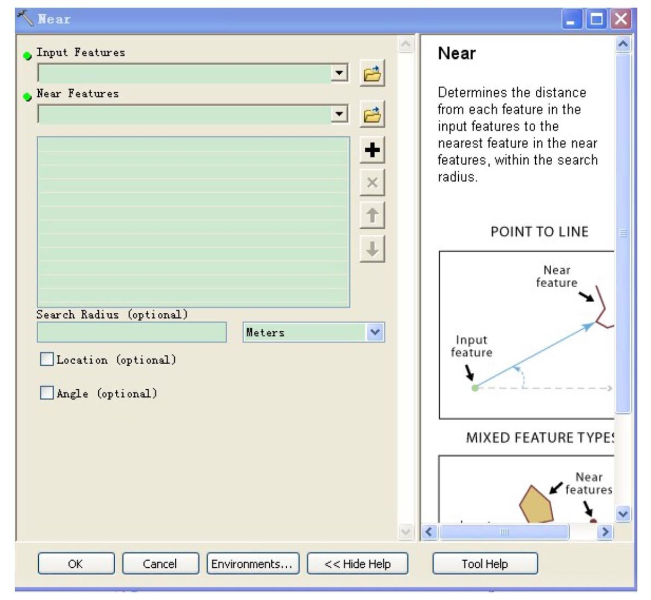
Data-3: Processing
Find Distance
For each restaurant(lat1, lon1) and
its nearest stop(lat2, long2), calculate t
he distance between them.
( Earth radius= 6,371,000 m)
Distance = ACOS( SIN(lat1*PI()/180)*SIN(lat2*PI()/180) + COS(lat1*PI()/180)*COS(lat2*PI()/180)*COS(lon2*PI()/180-lon1*PI()/180) ) * 6371000
Calculate walking time: stop---> restaurant
(with adult walking speed 1.4 metres per second)
Distance*60 /1.4
Find the nearest shuttle stop for all restaurants using ArcMap.
The Near tool calculates the distance from each point in one feature class to the nearest point or line feature in another feature class.
Find Walking Time

Slide 10
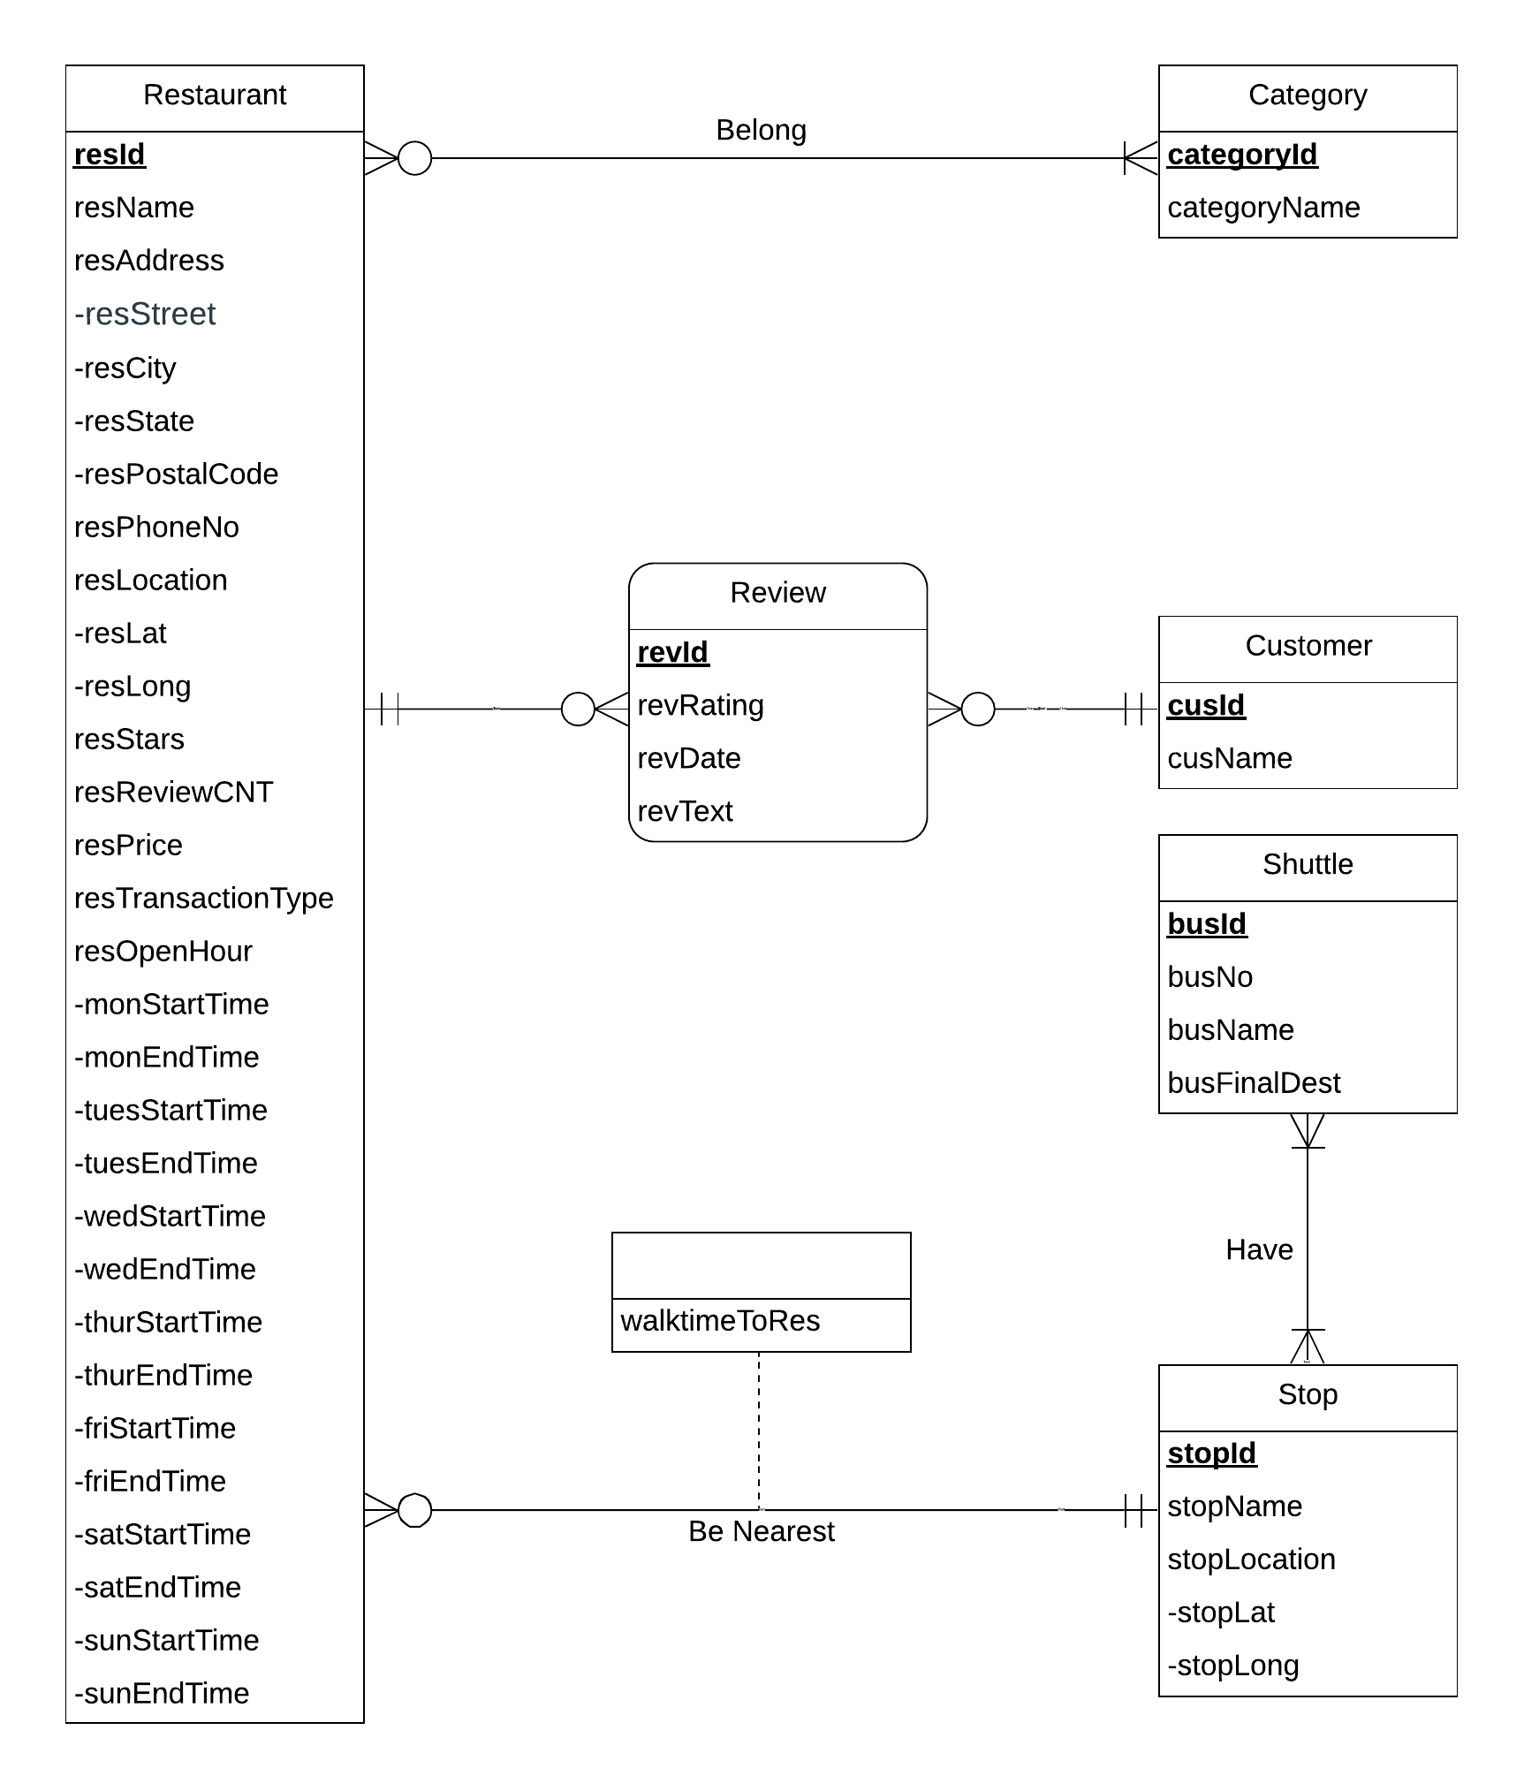
ER Diagram

Slide 11
Relational Schema
● Restaurant(resId, resName, resStreet, resCity, resState, resPostalCode, resPhoneNo, resLat, resLong, resStars, resRevCNT, resPrice, resTransactionType, monStartTime, monEndTime, tuesStartTime, tuesEndTime, wedStartTime, wedEndTime, thurStartTime, thurEndTime, friStartTime, friEndTime, satStartTime, satEndTime, sunStartTime, sunEndTime, stopId, walktimeToRes)
● Category(categoryId, categoryName)
● Customer(cusId, cusName)
● Review(revId, revRating, revDate, revText, cusId, resId)
● Shuttle(busId, busNo, busName, busFinalDest)
● Stop(stopId, stopName, stopLat, stopLong)
● Belong(resId, categoryId)
● Have(busId, stopId)

Slide 12
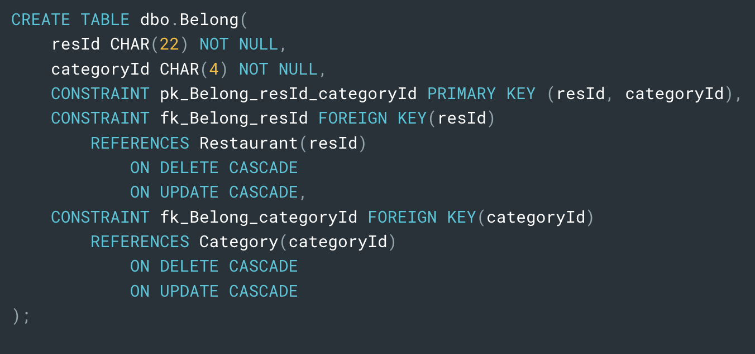
Physical Database Design

Slide 13
An Entrepreneur Dilemma
WHERE to open restaurant?
Which RESTAURANT THEME?

Slide 14
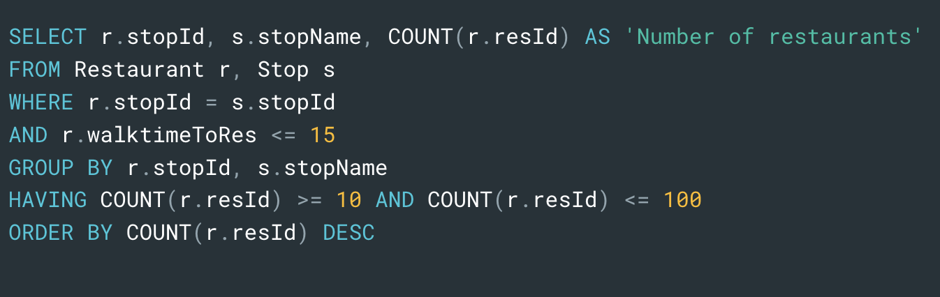
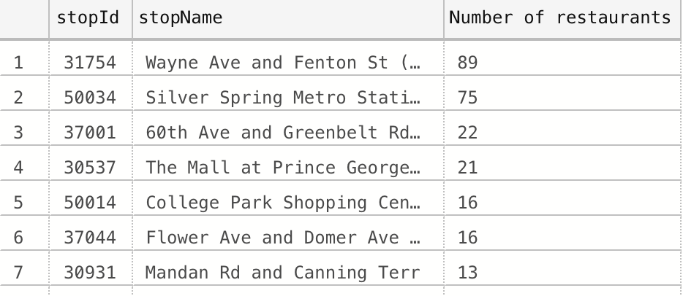
Use Case 1- Determine Location
Which stops have between 10 to 100 restaurants within 15 minutes walkable distance ?

Slide 15
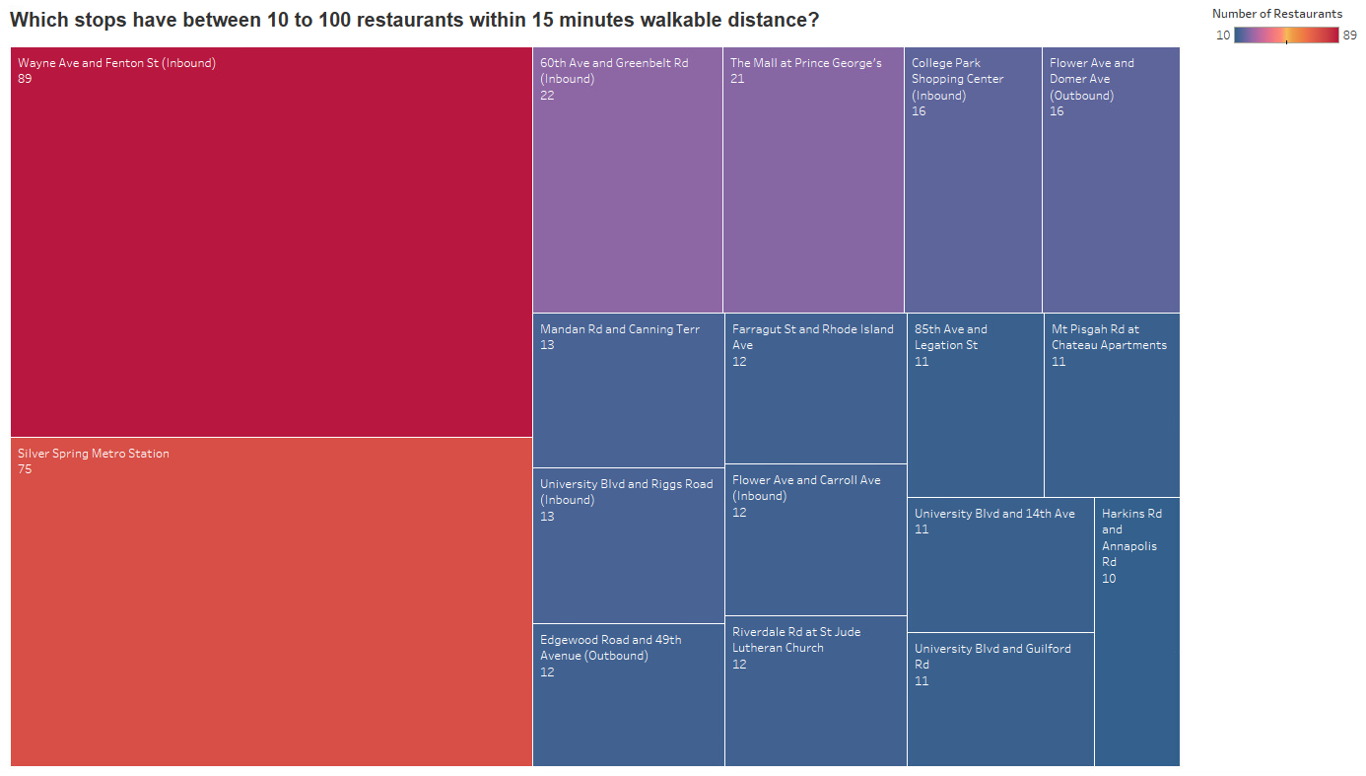
Preferred Locations
Finalized Cities:
Silver Spring
Berwyn Heights
Hyattsville
College Park
Takoma Park
Greenbelt
Chillum
Riverdale
New Carrolton
Lanham
Langley Park

Slide 16
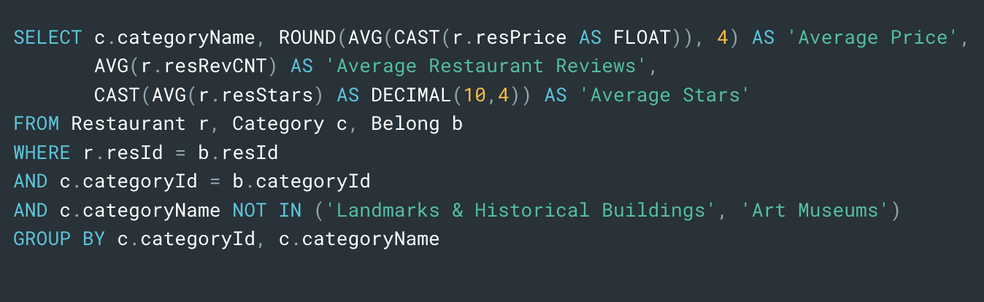
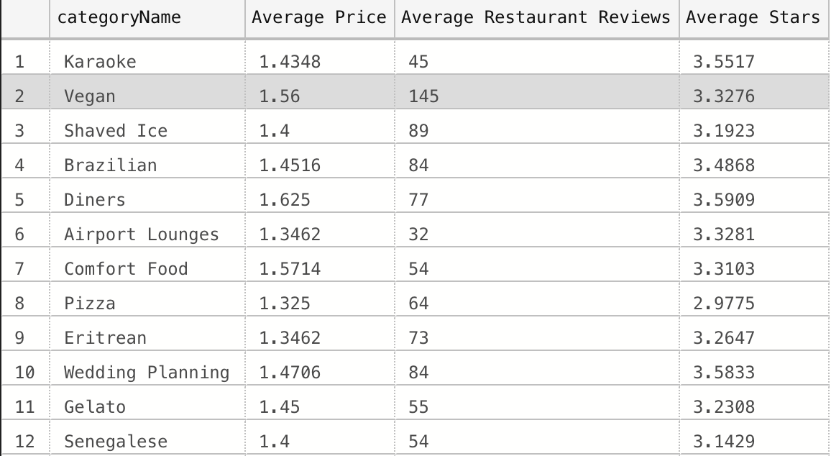
Use Case 2 - Determine Restaurant Theme
What are the average restaurant price,
average review count, and average restaurant rating for
each category in all cities?

Slide 17
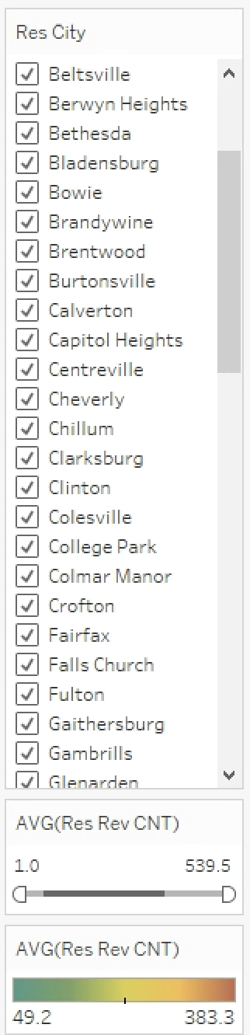
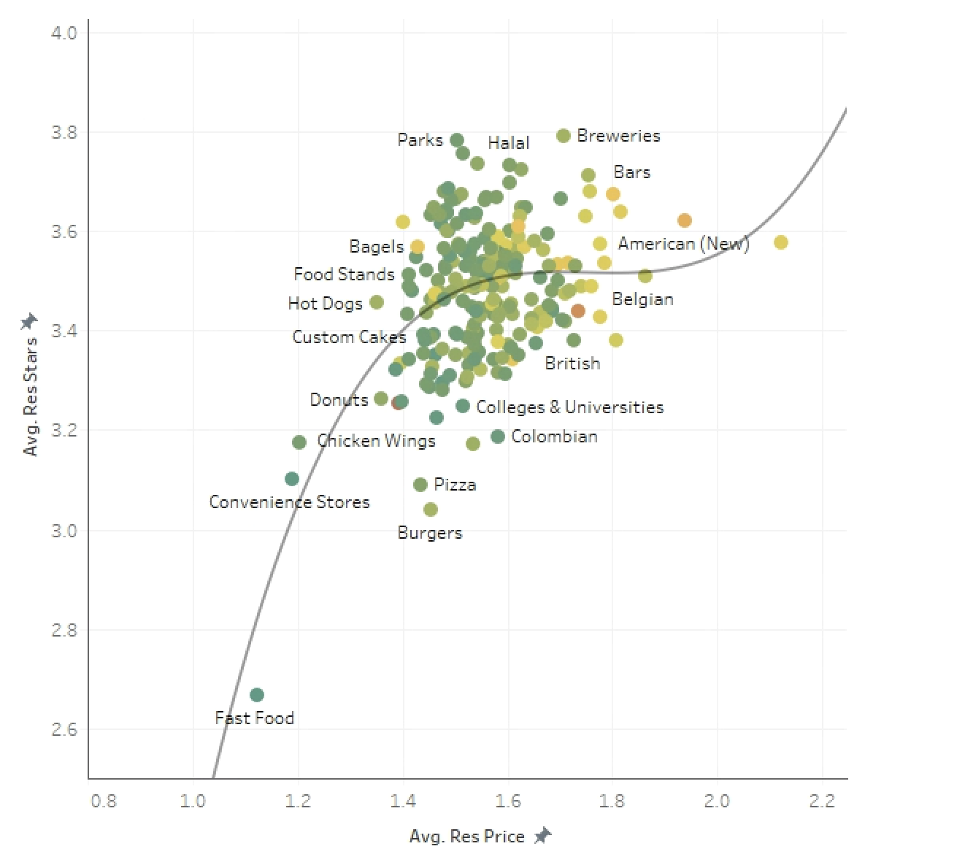
Determine Restaurant Theme
Avg. Price: low->affordable
X-Axis
Avg. Rating: high->Well-received
Y-Axis
Avg. Review count: well-known
Color

Slide 18
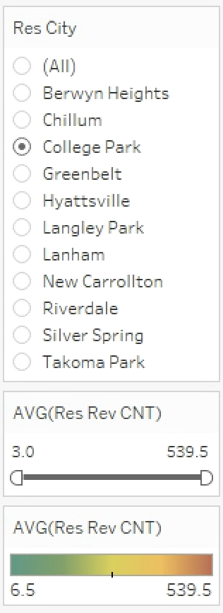
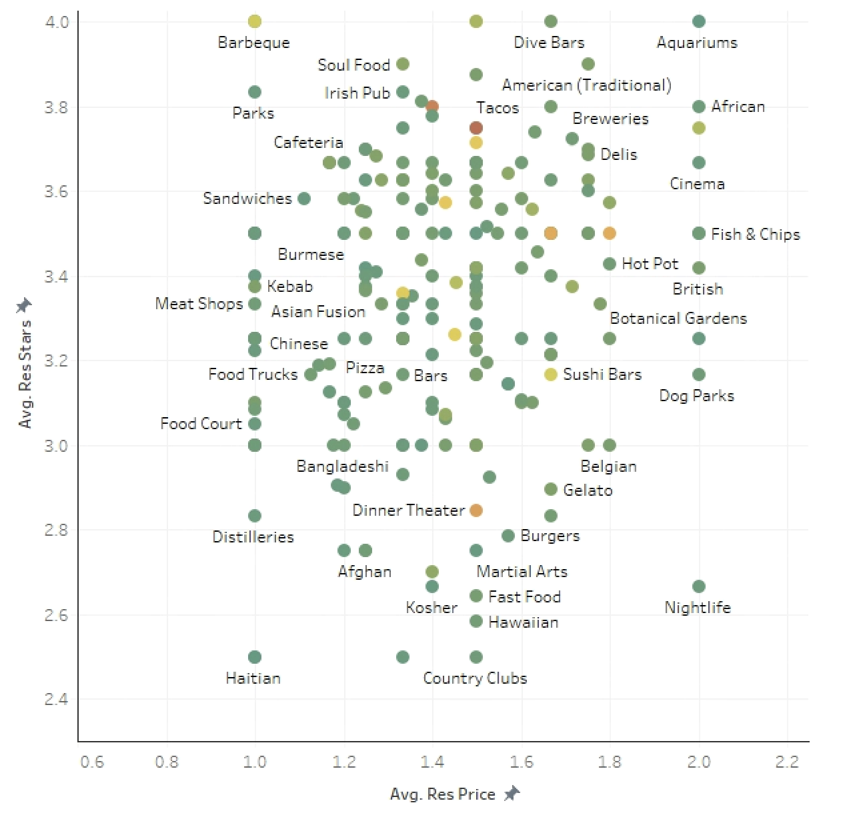
Filter for 11 recommended cities

Slide 19
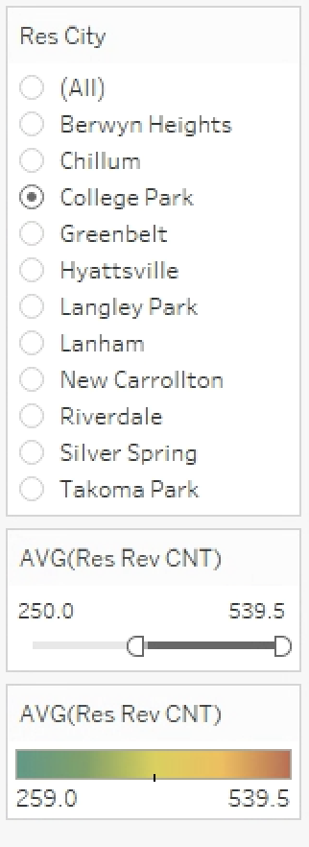
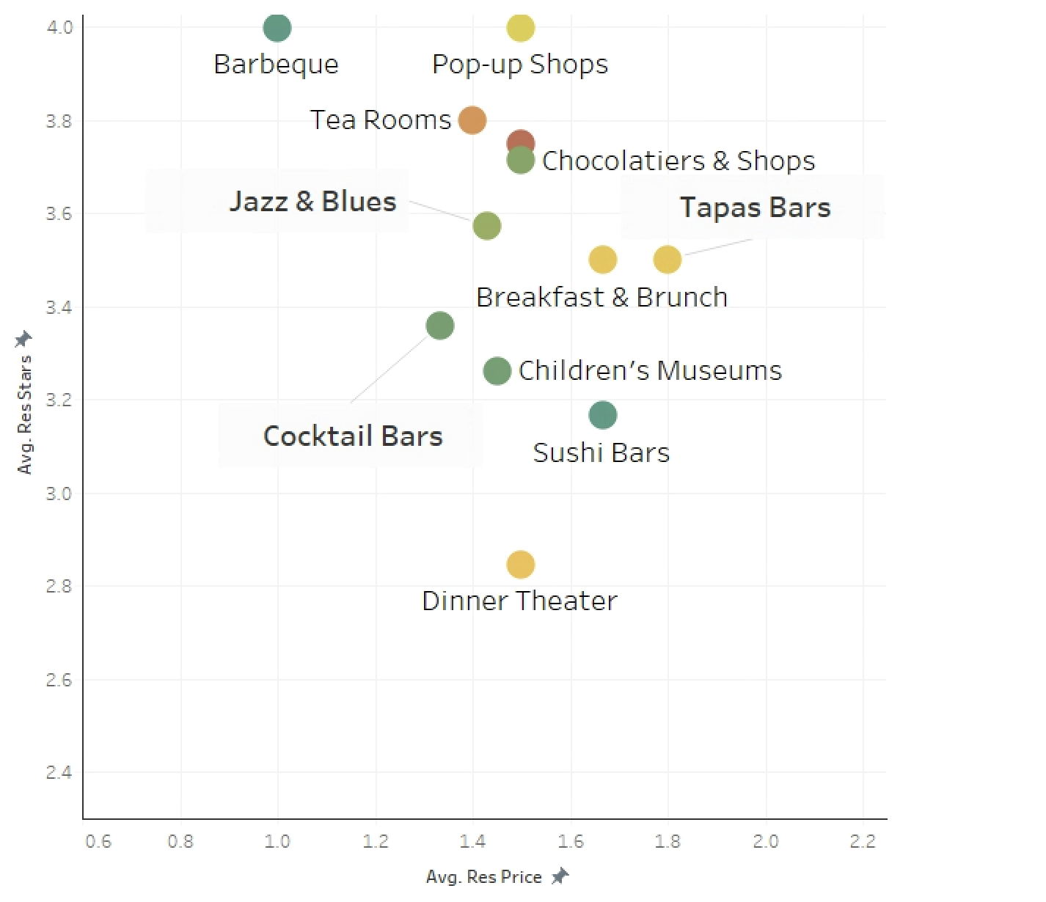
IF Open at College Park
Well-received,and affordable
well-known

Slide 20
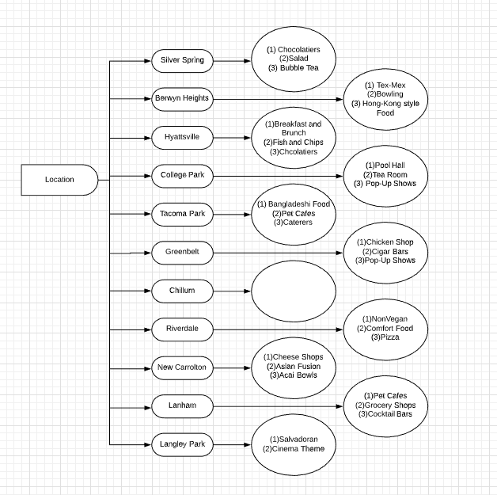
Results
(1)Barbecue
(2)Tea Romm
(3)Pop-Up Shop

Slide 21
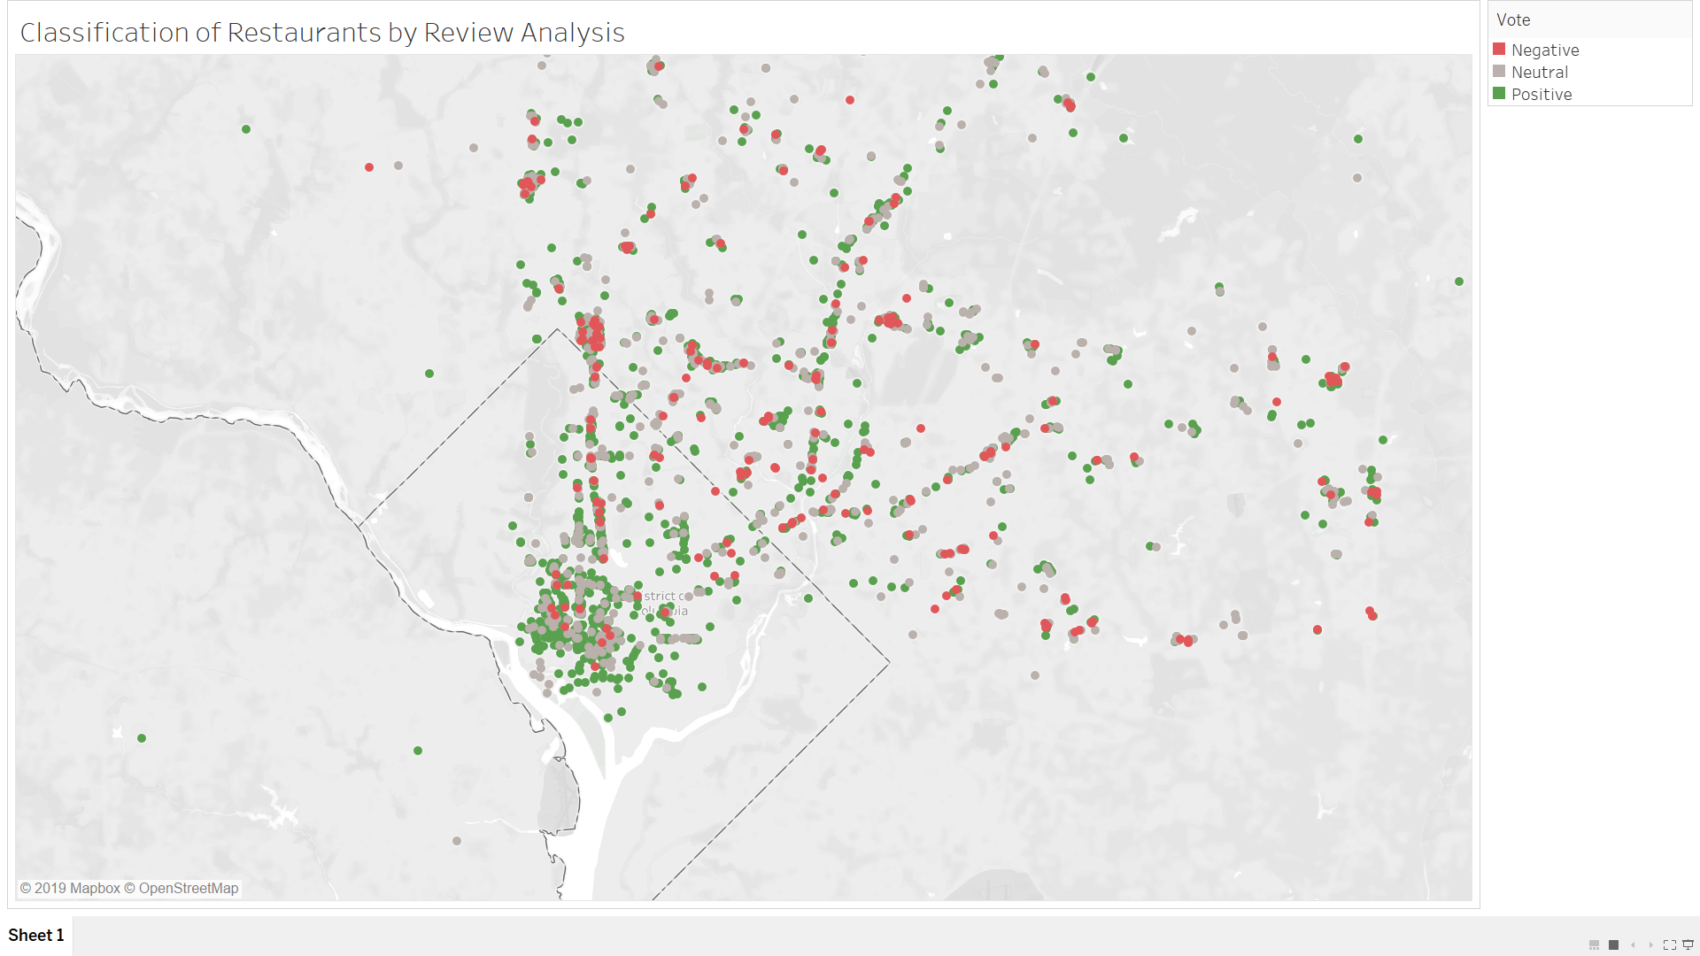
Review Text Sentiment Analysis
Used positive and negative words compiled by Bing Liu and Minking Hu.
Classification of restaurants based on whether the majority of reviews received by the restaurant are positive, negative or neutral
Small scale model with lesser number of reviews per restaurant.

Slide 22
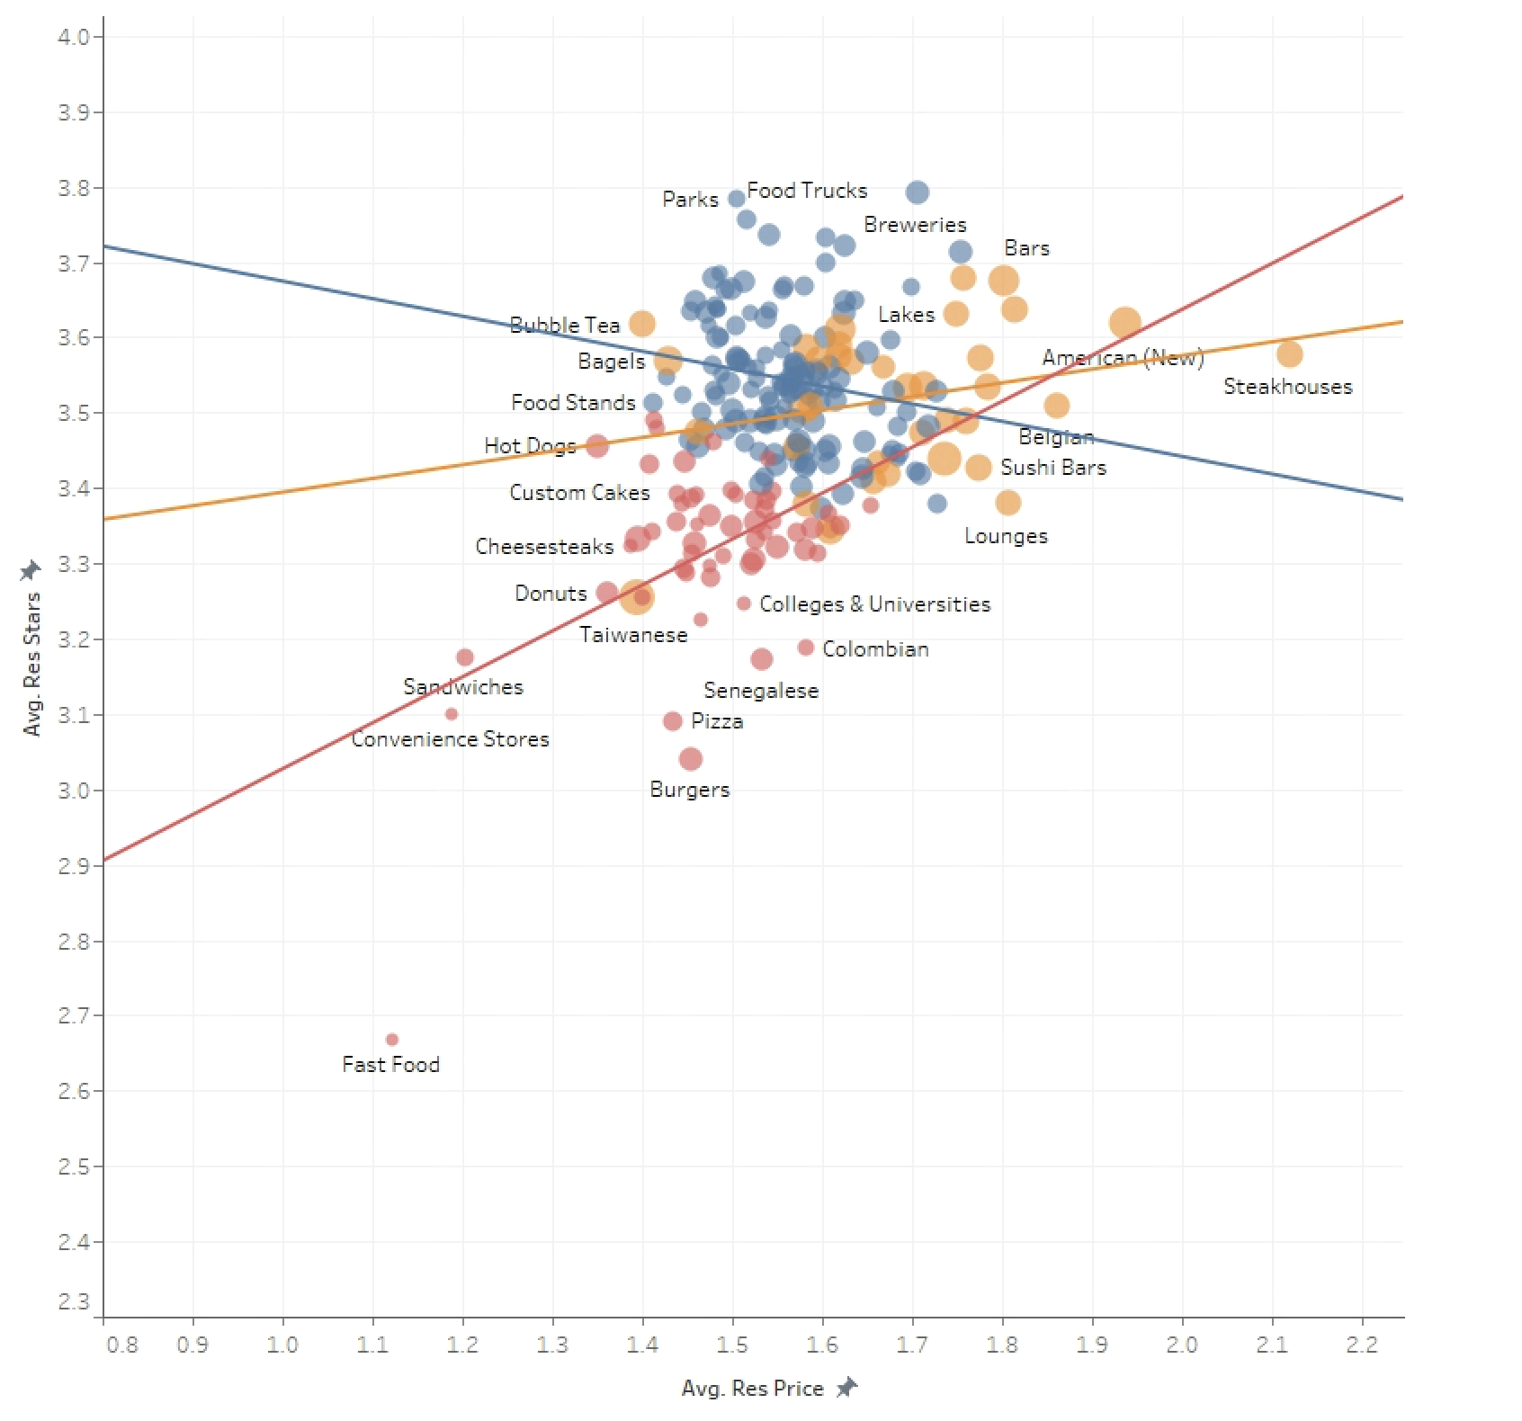
Future Plans
1. Complete interactive website
2. Text Analysis:
Help label categories better and reflect restaurant rating better (using sentiment analysis, machine learning, clustering).
3. Recommendation System:
recommend restaurants that match customer’s preference based on past review texts (using machine learning method)

Slide 23
Thank you
Q&A

